Slide 1





Safe at home - Safe online
A training presentation to help you keep safe online. The Friendly Information Company working together with Speakup self-advocates.

Slide 2

Stolen Identity – what does this mean?
Someone is pretending to be you!!!!
Let’s think about this for 5 minutes, together talk to someone you trust about this

Slide 3
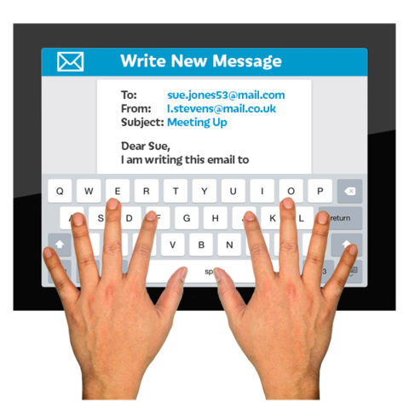
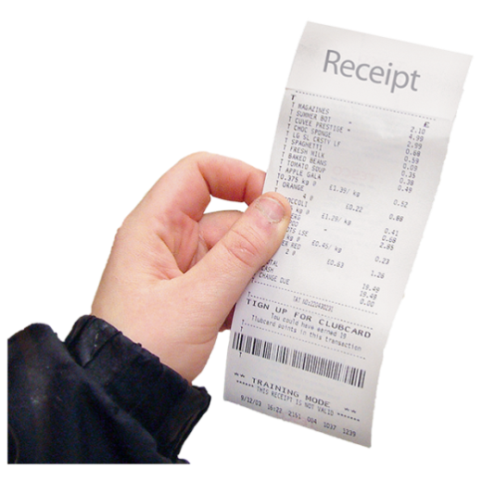
What to look for to make sure that your identity isn't stolen
Check for signs that may mean someone is pretending to be you
These might be;
Remember to use strong passwords
Scammers are very smart and will use places you know
If you have purchased something online make sure you keep track of your order.
Remember to keep the receipt or receipt email after your order has come
Ignore any more emails from the place you have ordered in case it’s a scam, you have what you ordered you don’t need to open anything else.

Slide 4
What to look for to make sure that your identity isn't stolen
Credit cards arriving in the post you didn’t apply for
Bills from companies you do not know
Asking you about bills you don’t recognise.

Slide 5
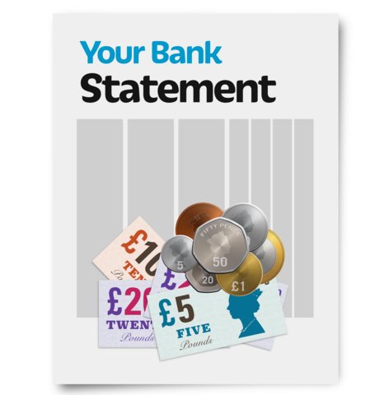
Turned down
Being told you’ve been given or turned down for credit for accounts you don’t know anything about.
Being refused when you apply for a loan or credit card

Slide 6
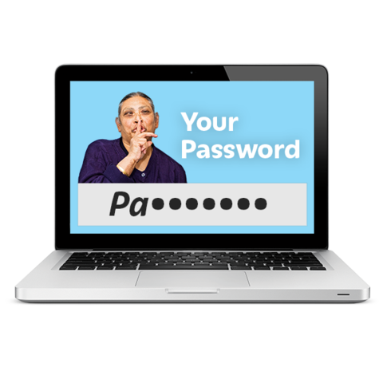
What is a strong password?
You can stay safer online by using strong passwords.
Remember to use strong and different passwords.
You could, for example, use three different words, and also use Capitals, Numbers and Punctuation in the password. Make sure you use different passwords for different accounts.

Slide 7

What is a strong password?
Spend 5 minutes thinking about what a strong password is and how you can remember them?

Slide 8
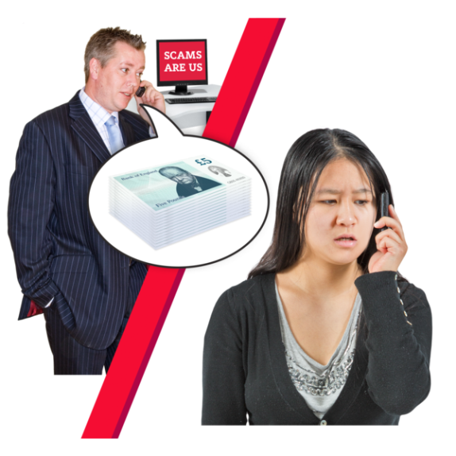
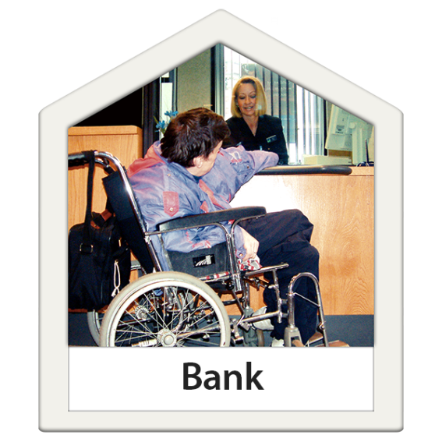
What to do if you think someone is pretending to be you?
ACT QUICKLY if you think someone is pretending to be you, this is called identity fraud. This may even happen when you are abroad.
Get in touch with your bank, credit card company and tell the Police, Crimestoppers or Action Fraud and say someone is pretending to be you. Tell them what’s happened.

Slide 9

What to do if you think someone is pretending to be you?
Report it to Action Fraud or ring your local police number
People or businesses who are victims to identity fraud should report it to Action Fraud on 0300 123 2040 or on their website..

Slide 10


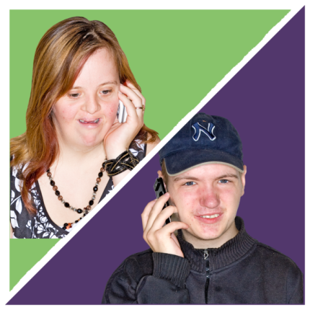

If you think you are a victim of fraud here are 3 things you can do
Get victim support
Contact Victim Support for free, private advice and support.
Report fraudsters
If you have information about identity crime please tell the Crimestoppers, Police or Action Fraud.
Possibly get extra protection
Use a Protective Registration service to try to stop fraud taking place in your name but you may have to pay for this service. Talk together about what a Protective Registration Service is.

Slide 11
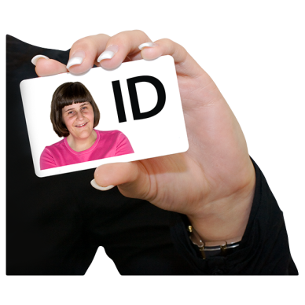

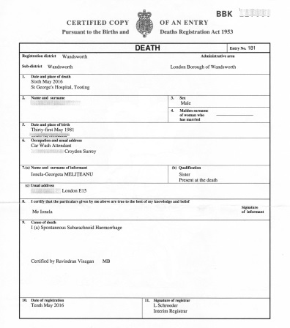
Your Identity can be stolen even if you have died
What should you do if the identity of someone you know who is dead, is stolen.
If you think that the identity of someone you know who as died maybe being used by a fraudster, talk to the police, maybe the bank or a (Protective Registration Service) but you may have to pay for this service.
You may to need to send a copy of the death certificate when you report this.

Slide 12
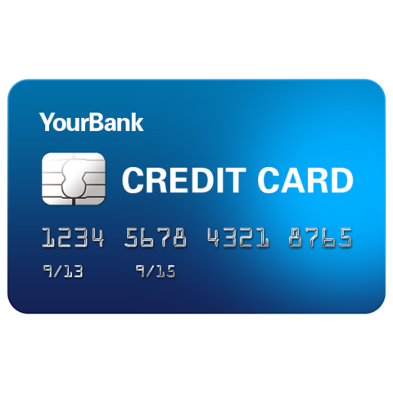


Forms of Identity Theft
Theft
You could have your personal things stolen which may give access to different forms of your ID.
Let’s think for a few minutes about the types of personal identity things that could be stolen that would give thieves your identity.

Slide 13


Forms of Identity Theft
Hacking
Software’s is used to hack into your computer, or information is taken from your smart phone
Your computer is hacked

Slide 14

Forms of Identity Theft
Cold-calling (strangers calling)
Fraudsters call you pretending to be a business and mislead you into giving away personal and financial information (money).
They might make background noises so you think it’s a call centre.

Slide 15
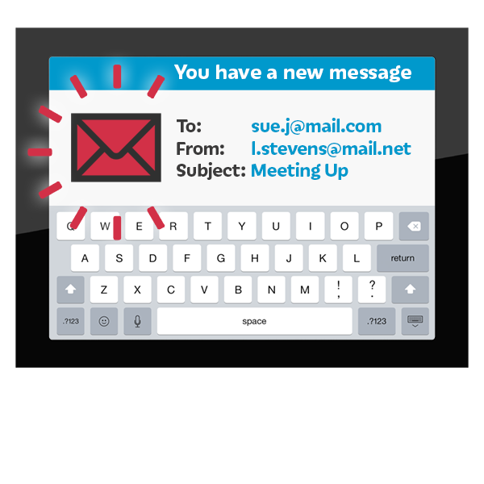
Forms of Identity Theft
Phishing
Fraudsters send an email that seems to be from company you might know, asking you to click a link or download an attachment which might put a virus on your computer and allows them to get your personal information.

Slide 16
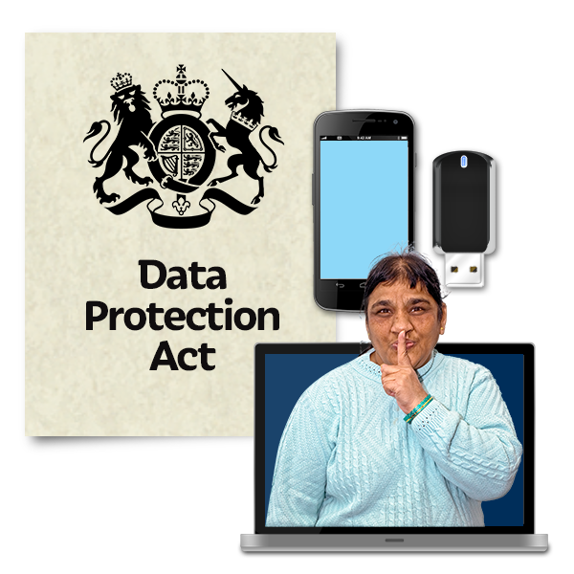

Forms of identity Theft
Data breach – this means people getting your personal information such as your address, telephone numbers etc. because a company has been hacked.
Can you think what these are. Talk about this together.

Slide 17

Identity Theft
If fraudsters start using your identity it can look like you’re making bad decisions.
This might mean that you can’t get credit if you need to or stop you renting property, and getting services in the future.
You’ll need to act quickly if you think this is happening to you and tell somebody like the police or your bank.
Ask someone you trust to support you if you need to

Slide 18


Thank you listening or reading together this presentation
Be aware and remember use strong passwords and act quickly if you think someone has stole your identity. Report it.
Identity fraud could affect your life in a bad way.
Keep talking about being ‘Safe at Home and Safe Online’ together to help you stay safe.

