Slide 1





Safe At Home - Safe Online

Slide 2
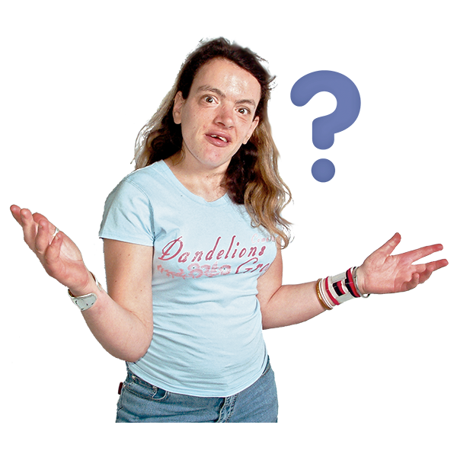
Are You Safe Online?

Slide 3
Are You Safe Online?

Slide 4
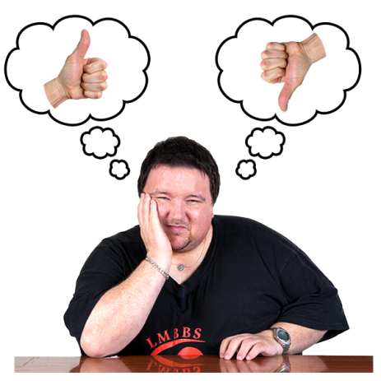

Let’s be safe at home when online
Let’s look together at some of the things that keep people safe when online.
It’s a good idea to talk about these things together and support each other to stay safe.
This training presentation will help you do that.
So let’s start with antivirus software. So what is it?

Slide 5
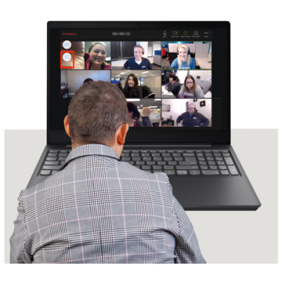
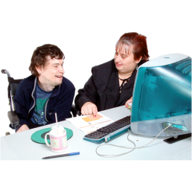


What is a trusted internet antivirus software?
Antivirus software protects you from online threats, such as viruses and other bad things called malware this can harm your computer or get to your personal information
There are lots of different ones ask someone you trust to help you get some for your computer
This is sometimes called internet security
Do not click on anything you are worried about or anything you do not know

Slide 6
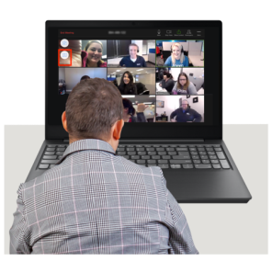
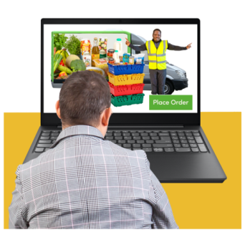


The good things about using the internet
Let’s think about all the good things about using the internet. We can:
Look for any information we want or need
Use social media to talk with family and friends
Play games online
Do online shopping
Booking things like train or cinema tickets
Can you think of anymore? What do you use the internet for? Spend 5 minutes thinking about all the good things we use the internet for

Slide 7

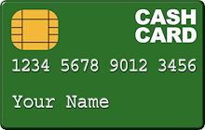


The bad things about using the internet
Now let’s think about all the bad things about using the internet.
Everyone is vulnerable to online fraud, use these training resources to remind you how to keep safe.
You can be one click away from a virus, or other malware, that could break your computer.
Your identity or bank card details can be stolen by scammers and hackers

Slide 8

The bad things about using the internet
Now let’s spend 5 minutes thinking about other bad things when using the internet

Slide 9



Do's and Don'ts when using the internet
When looking on the internet this is called browsing, you should do these things:
Make sure you have a trusted internet anti-virus software on your computer
Be careful what you click on
Only use websites that you know are trusted when ordering online.
Look for the padlock and the https:// at the start of the web address. This means the website safe.

Slide 10
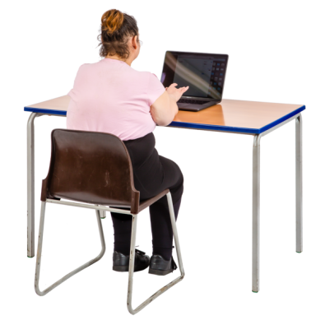

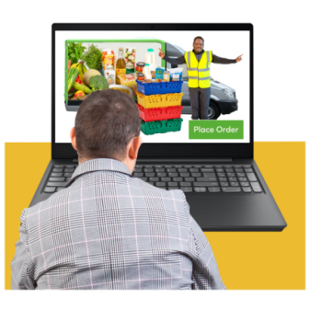
Don'ts when using the internet
When browsing the internet, you must NOT do these things:
Click on links you don’t know, especially if they pop up on your screen or appear on an email
Shop on websites you’ve not heard of

Slide 11
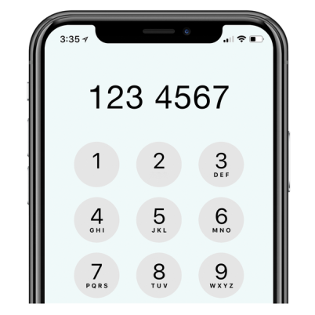
Don'ts when using the internet
Browse the internet without any internet security software
Give away your phone number or any of your personal details to someone you don’t know

Slide 12
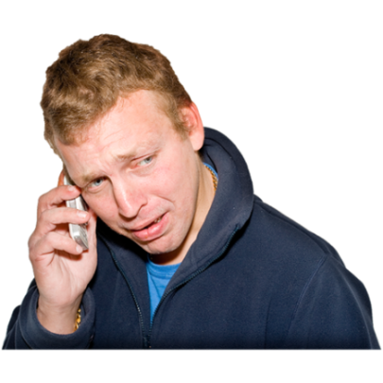

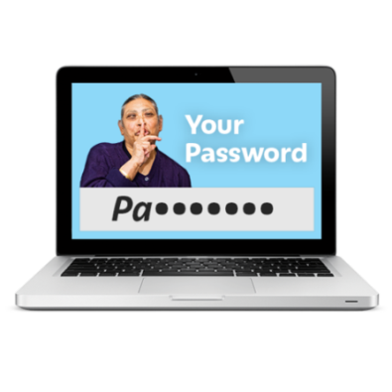

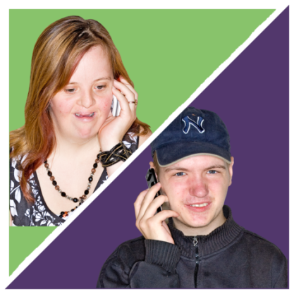
Never
Give away your phone number or any of your personal details to someone you don’t know
If you are on a dating or social website be very careful and maybe meet the person first of all with a friend for a coffee or in a busy pub before you meet them alone.

Slide 13
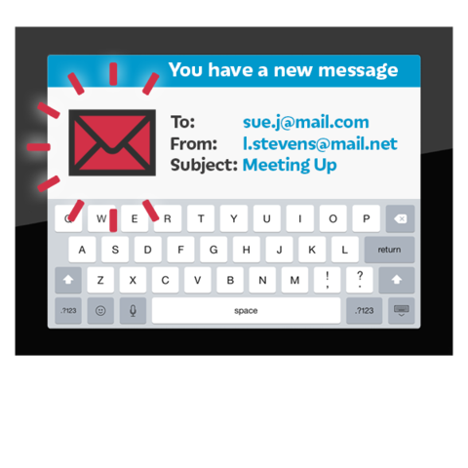
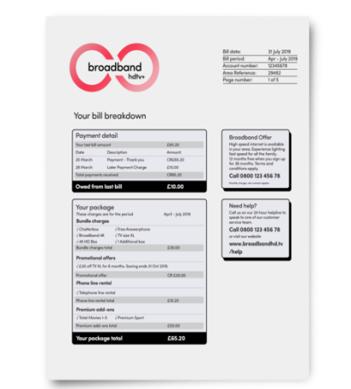
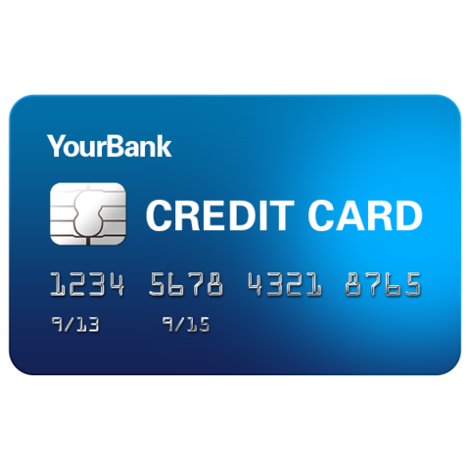
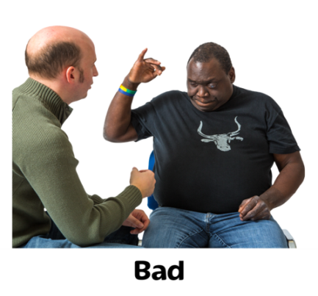
keep your personal information safe online
You need to be careful about other things too:
Emails about things you didn’t buy
Emails asking for payment for an account you didn’t set up
Credit cards arriving in the post you didn’t apply for
Bills from companies you’ve don’t know
Debt collection contacting you about bills you don’t recognise

Slide 14
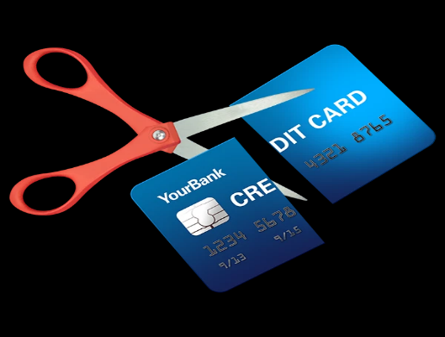
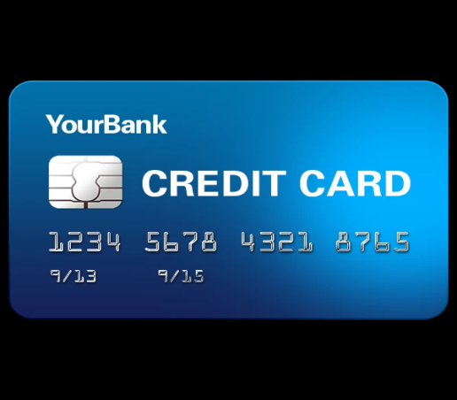
Keep your personal information safe online
Being told you’ve been accepted or not accepted for credit or accounts you know nothing about
Being told “no” when you apply for a loan or credit card even though you know you’ve not in debt
CHECK everything that comes into your inbox but don’t clink if you are not sure. Look for any risky activity and report or ask someone you trust to help you report it, to the police

Slide 15
Thank you for reading this presentation, now watch the films and keep talking about internet safety with your friends and family and people you trust
Be safe online.

