Slide 1


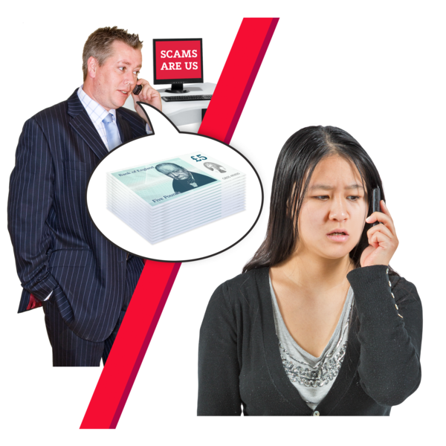

What is fraud?

Slide 2

What is fraud?
Let’s spend a few minutes thinking about what fraud is and what it might mean to you.

Slide 3

What is Fraud?
Fraud is big and there are lots of different types. On the next slide there are some words that might describe it.
There are lots of them so what do we think they mean? Let’s take a few minutes to think and talk together about these words.

Slide 4
What is Fraud?
These are some of the descriptions of fraud we have found:
scheme
con
swindle
fiddle
deception
cheat
dodge
rip off
Can you think of anymore?
Fake
sham
phoney
treachery
dishonesty
racket

Slide 5
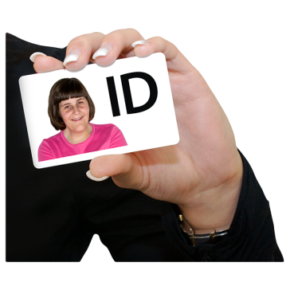

What fraud means
Fraud can be when someone steals your identity, that means pretends to be you. Lies about something and gets something from you by lying.

Slide 6

What fraud means
People who commit fraud and fake websites can be hard to spot, but keep safe with a couple of simple rules, these are:
Don’t trust anyone you haven’t met and look for the padlock and https:// at the start of the website address.

Slide 7


What fraud means and how to spot it
If you don’t know about a website, you can do a search of the website with the word “review” or “Trustpilot” after it, to find out how secure it is.
And remember to use your web security and check for the padlock and https:// at the start of the address!

Slide 8


Different type of fraud
What are the different ways you can be scammed or have a fraud committed against you?
Let’s think about this now.

Slide 9



How to look out for scam emails, texts and phone calls
You might get an email from an organisation or a person you haven’t heard of, or sometimes it might claim to be from an organisation you do know.
These can be very hard to spot. If you are not sure, ask a trusted friend to see what they think and check online to see if there is a recognised scam happening.

Slide 10


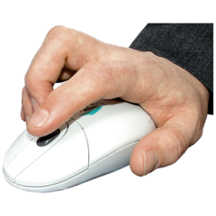

How to look out for scam emails, texts and phone calls
The email or text might be trying to sell you something, ask you to pay for something or be offering compensation for an “accident” that you haven’t had.
Do not click on any links you see in any of these emails!
Do not pay any money to these organisations!

Slide 11
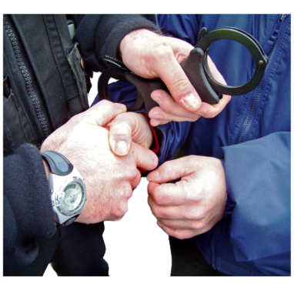
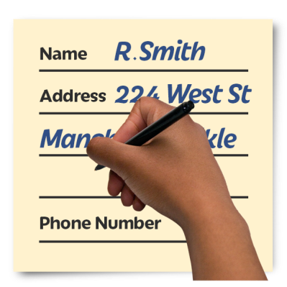
How to look out for scam emails, texts and phone calls
The company might say that if you don’t pay the amount asked for, you will be arrested or fined
Try not to worry about this, because banks, the Police, HMRC or other companies would never ask you for any personal details

Slide 12
Marshall’s story
I put my laptop for sale on Ebay this is an auction site where you can sell new and used items for sale. A couple of days later this man contacted me and told he would buy the laptop for £800 and pay for delivery.
I felt really pleased that I had sold the laptop so quickly and a few hours later I took my laptop down to the post office and sent it off. When I got back I had an email from PayPal telling me that I had to put £500 into my Paypal account so that the person buying the laptop from me would upgrade my account on PayPal to a business account.
I did a bank transfer of £500 to the bank account and I received an email saying the money would take 24hrs to clear.
Two days later the buyer sent me a message on Ebay saying his grandson had accidently put another £1000 into my account again meaning £2080 was in my PayPal account. The buyer became quite threatening towards me and said If I didn’t transfer him the money and this didn’t clear by a certain time I would be responsible for his death.
I noticed this was a scam because the bank details to transfer the money again the payment details were different. So I rang PayPal and they told me that I had no transactions pending, I realised it was a scam.
I had to contact the courier to see whether the laptop had been delivered to address however, it had a failed to get delivered. I was able to get the laptop returned to me but lost £500.
I contacted Lloyd’s fraud department they told they are unable to offer a refund.
I have learnt that there are lots of different ways you can be scammed, and that you shouldn’t trust what everyone is saying is the truth.

Slide 13
Jodie’s Story
I had a phone contract with O2 and I was about to leave them to go to another provider. I received an email from O2 telling me that I was entitled to some money back just over £300. The email looked real it had the 02 logo on and it also had someone’s name on it. I talked about this with my colleagues and they too thought that the email looked real, it wasn’t asking for any bank details etc. and there was no link.
With the help of my colleagues I phoned 02 and told them the person’s name and they told me that person didn’t work for 02. They reported the email to their fraud team. The person who I spoke to told me that they would only contact me about a refund by writing to me and asking me to contact them.
I was entitled to a refund and I got over £300 back but the email was fraudulent. From this scam I learnt that you really have to read things correctly and double check details, I was so close to being involved in a scam.

Slide 14
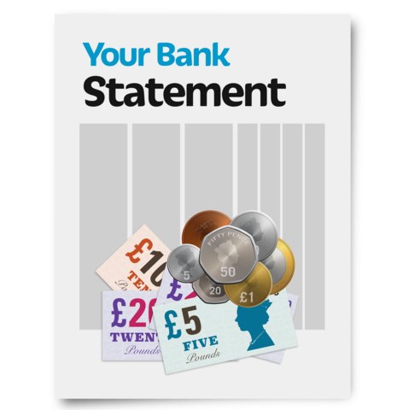

How to keep your personal information safe
Watch out for things you do not recognise on your bank account. For e.g. someone taking £10.00 first time, then £25, then £50…
You should regularly check your bank statements or online banking for things that you did not buy and for charges that you don’t know about.

Slide 15
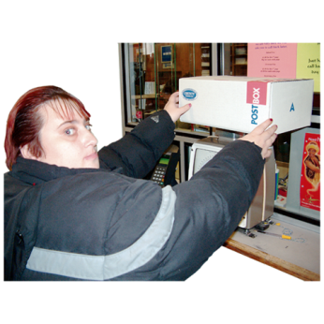



How to keep your personal information safe
If you have ordered goods but not received them, this could be a sign that it’s been sent to someone pretending to be you. Called a fraudster
This is someone who might try to steal your identity, take your money or goods

Slide 16


Remember, Scam messages can be very hard to spot
Be careful of unwanted messages
You can make yourself safer and more aware of crime by being wary of unwanted emails, calls and texts.
These emails, calls or texts might ask you for information about your passwords, logins or other security details. Ignore them and delete them!

Slide 17


Remember to update your software!
Make sure you update the software on your devices regularly
Always be careful when using public Wi-Fi. You can use it for general browsing, but never use it for shopping or banking

Slide 18
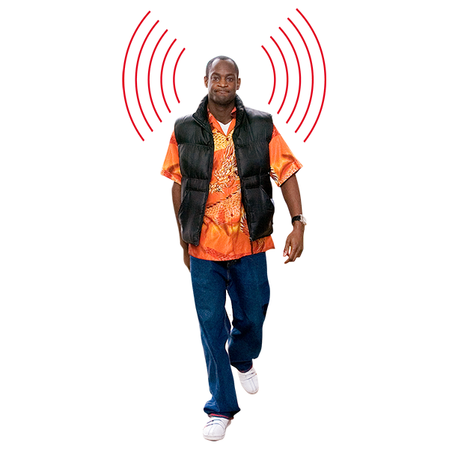
Remember here are a few key steps you can take to prevent identity theft online
Protect your computer and smartphone with strong, up-to-date security software.
Use strong passwords.
Only use websites you can trust when buying things online
Stay alert.

Slide 19

If we buy something on the internet, how do we pay for it safely?
Only use online retailers (shops)you know and can trust
Only use websites that start with https:// and show a padlock
Always use internet security, making sure secure web browsing is turned on. If you don’t know how to do this ask someone you trust to help

Slide 20
Buying on the internet
Make sure you don’t save your payment details on the website – unless it’s one you know you can trust.
Lots of websites like to have your details saved for future shopping purchases.

Slide 21
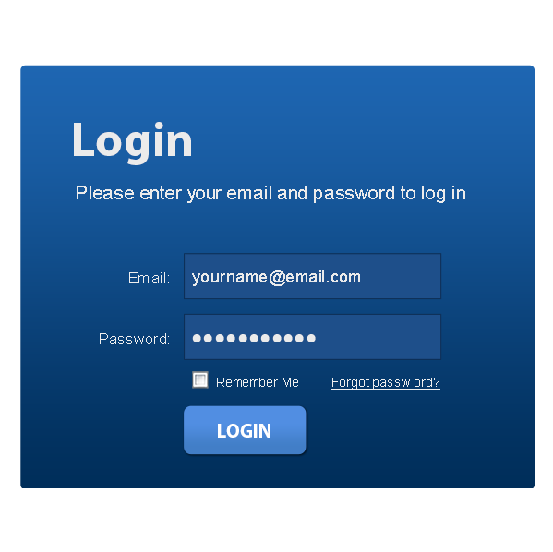
Buying on the internet
If you are signing up to a subscription,(let’s talk about this) make sure you understand the rules, these are called terms and conditions of the contract.
You may not be able to end the contract when you want to.

Slide 22


Here is a useful checklist for stopping fraud
Report fraudsters
If you have information about anyone pretending to be you. Tell the police or an independent charity like ‘Crimestoppers’
Get victim support
If you have been a victim of fraud, you can contact Victim Support for free, private advice and support.

Slide 23

Protective Registration Service
If you are at risk or a victim of identity fraud you might want to use a Protective Registration service to try to prevent fraud taking place in your name. But you may have to pay for this.

Slide 24


What’s this mail?
Be suspicious of any unwanted emails, even if you think they are from a company you know.
Don’t open the attachments or click on links in unwanted emails, and never tell anyone any personal or financial (money) details.
If you receive any mail that seems suspicious or says you have an account with the sender when you don’t, ignore it.

Slide 25

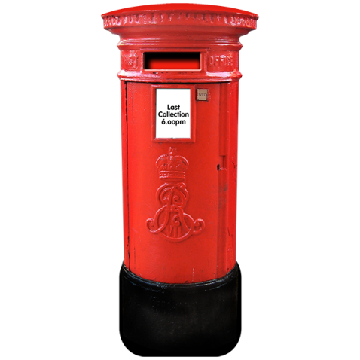
Where do you report suspicious mail?
If you think that your mail is being stolen, or a mail redirection application has been made in your name.
Contact Royal Mail Customer Care on 08457 740 740 or via their website.

Slide 26

Any questions?
We hope you have learnt lots about keep yourself safe online and watch the film together
Keep talking about this and keep safe everyone.
Are there any questions that we can answer together?

